Slide 1
Introduction to Bash Programming
Dr. Xiaolan Zhang
Spring 2013
Dept. of Computer & Information Sciences
Fordham University

Slide 2
Outline
Shell command line syntax
Shell builtin commands
Shell variables, arguments
I/O redirection
Shell tracing
Shell initialization

Slide 3
Last class
Shell:
Interactive mode:
Scripting mode
Command line
File system
Some commands

Slide 4
Command line
Short options (-) and long options (--)
In POSIX, use two dashes (--) to signify end of options, i.e., remaining arguments on command line that look like options are treated as arguments (for example, as filenames).
To delete a file named “-l”, rm -- -l
Semicolons separate multiple commands on same line. The shell executes them sequentially.
Ampersand (&), tell shell to run preceding command in background, which simply means that shell doesn’t wait for command to finish before continuing to next command.

Slide 5
Shell built-in commands
Shell recognizes three kinds of commands: built-in commands, shell functions, and external commands
Built-in commands: commands that shell itself executes
some from necessity:
cd to change current directory,
read to get input from the user (or a file) into a shell variable.
Other for efficiency:
test command, heavily used in shell scripting,
I/O commands such as echo or printf.
man cd will show all other shell built-in commands
Shell functions are self-contained chunks of code, written in shell language

Slide 6
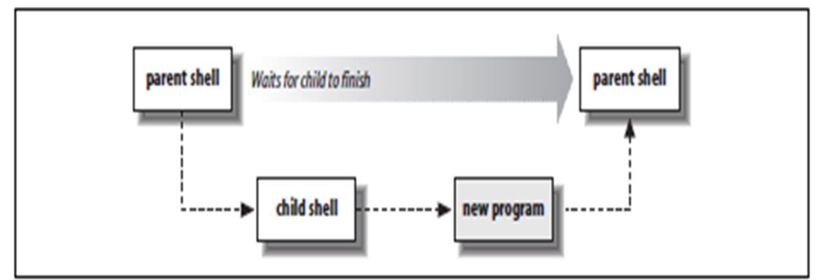
External commands
Implemented by another program
Shell runs by creating a separate process.
Create a new process.
In the new process, search directories listed in PATH variable for given command
/bin:/usr/bin:/usr/X11R6/bin:/usr/local/bin
Note: if command name contains /, skip this step
In the new process, execute found program
When the program finishes, shell continues
reading next command from terminal, or from the script.

Slide 7
echo
echo: produce output, prompting or to generate data for further processing.
printed its arguments to standard output, with each one separated from next by a space and terminated with a newline
$ echo Now is the time for all good men
Now is the time for all good men
$ echo to come to the aid of their country.
to come to the aid of their country.
Option: -n, omit trailing newline
$ echo -n "Enter your name: " ##Print prompt
Enter your name: _ Enter data

Slide 8
Escape character
To display special character, use -e option
echo -e ″Hello\tWorld″
Code for special character
\a Alert character, usually the ASCII BEL character.
\b Backspace.
\c Suppress the final newline in the output. Furthermore, any characters left in the argument, and any following arguments, are ignored
\f Formfeed.
\n Newline.
\r Carriage return.
\t Horizontal tab.
\v Vertical tab.
\\ A literal backslash character.
\0ddd Character represented as a 1- to 3-digit octal value.

Slide 9
Outline
Shell command line syntax
Shell builtin commands
Shell variables, arguments
I/O redirection
Shell tracing
Shell initialization

Slide 10
Variables
A variable is a name that you give to a particular piece of information.
Shell variable names: start with a letter or underscore, and may contain any number of following letters,digits,or underscores.
Shell variables hold string values, there is no limit on length of string value
variable values can be, and often are, empty—that is, they contain no characters.
Empty values are referred to as null

Slide 11
Variable assignment
Assign value to variable: writing variable name, immediately followed by an = character, and new value, without any intervening spaces.
myvar=this_is_a_long_string_that_does_not_mean_much
first=isaac middle=bashevis last=singer ##Multiple assignments allowed on one line
Shell variable values are retrieved by prefixing the variable’s name with a $ character.
echo $myvar ## display the value of myvar
this_is_a_long_string_that_does_not_mean_much

Slide 12
Variable assignment
Use quotes when assigning a literal value that contains spaces:
fullname="isaac bashevis singer" #Use quotes for whitespace in value
oldname=$fullname #Quotes not needed to preserve spaces in value
To concatenate variables:
fullname="$first $middle $last" Double quotes required here

Slide 13
Command Substitution
We can save output of a command into variable
$curr_dir=`pwd` ##save current directory in a var.
$Curr_time=`date`
$echo $curr_time
Tue Jan 22 09:39:22 EST 2013
Command substitution
One can embed a command with a backquote (`) in another command line
Shell will run embedded command, and use its output to replace the quoted part of original command
echo Time is now `date`
echo There is `who | wc –l` users online.

Slide 14
Example CountFiles script
Count files/directories in a directory
#!/bin/bash
# List the number of files (including those hidden files) and directories under the given directory
echo count the number of files under $1
ls -a -L $1 | wc -l

Slide 15
Positional/argument parameters
Positional parameters represent a shell script’s command-line arguments, also represent a function’s arguments within shell functions.
echo first arg is $1
echo tenth arg is ${10} ## For historical reasons, you have to enclose number in braces if it’s greater than nine
Other special argument variables:
$#: the number of parameters
$0: the command/script name
$*, $@: the list of all parameters ($1, $2, …), not including $0

Slide 16
Outline
Shell command line syntax
Shell builtin commands
Shell variables, arguments
Standard I/O, I/O redirection, Pipeline
Shell tracing
Shell initialization

Slide 17
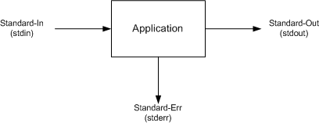
Standard I/O
All programs should have a data source, a data sink (where data goes),and a place to report problems. These are standard input, standard output, standard error.
Standard input, by default is linked to keyboard
Standard output, by default is linked to terminal window
Standard error, by default linked to terminal window
A program should neither know, nor care, what kind of device lies behind its input and outputs: disk files, terminals, tape drives, network connections, or even another running program!
A program can expect these standard places to be already open and ready to use when it starts up.

Slide 18
Simple example
A very simple C program
#include <stdio.h>
main() {
char yourName[256];
printf ("Your name ?\n"); // Similar to cout
if (fgets (yourName,256,stdin)==NULL) //similar to cin
fprintf (stderr,"No input");
else
printf("hello, %s\n", yourName);
}

Slide 19
Input/Output Redirection
On command line, one can redirect these three files
To redirect standard output to a disk file:
command [ [ - ] option (s) ] [ option argument (s) ] [ command argument (s) ] > FILENAME
Execute the command, sending its standard output to specified file
Existing content of the file is deleted
E.g.: ls -lt > InfoFilelist.txt
To append standard output to a file: use >> instead of >
grep “tax reform” *.txt > output
grep “fuel efficiency” *.txt >> output

Slide 20
Input/Output Redirection (cont’d)
To redirect standard error to a file
$ command [ [ - ] option (s) ] [ option argument (s) ] [ command argument (s) ] 2> ERRORMSGS
Examples:
[zhang@storm ~]$ ls abc
ls: cannot access abc: No such file or directory
[zhang@storm ~]$ ls abc 2> error
[zhang@storm ~]$ more error
ls: cannot access abc: No such file or directory

Slide 21
User > and 2> together
To split error messages from normal output
[zhang@storm ~]$ ls research.tex abc
ls: cannot access abc: No such file or directory
research.tex
[zhang@storm ~]$ ls research.tex abc 2> error > output
[zhang@storm ~]$ cat error
ls: cannot access abc: No such file or directory
[zhang@storm ~]$ cat output
research.tex
This is useful for running a command that might take long time to finish, or generates very long output …

Slide 22
More on redirection
To redirect both output and error to same file:
./a.out > dd 2> dd : does not work. Error output is not captured.
sort file.txt > dd 2>&1
2>&1: redirect error output to same place as standard output
grep numOfStudents 2>dd >&2
>&2: redirect standard output to same place as error output
To discard output, redirect it to /dev/null
/dev/null: a special virtual file, “a black hole”
./a.out > /dev/null 2>&1
I don’t want to see the output or error message, nor do I want them saved to a file …

Slide 23
Input/Output Redirection (cont’d)
To read standard input from a file, instead of keyboard
$ command [ [ - ] option (s) ] [ option argument (s) ] [ command argument (s) ] < FILENAME
Examples
mail zhang –s “Question” < proj1.cpp
./a.out < values.txt
//a.out is your program that reads integers from standard input and calculate the sum

Slide 24
Combining commands together
How many files are there under current directory ?
ls > tmp
wc –l < tmp
rm tmp
Sort current online user by alphabetic order
Is some user login to the system now ? (using grep)
Is file “tmp” listed ?

Slide 25
Pipe: getting rid of temporary file
Pipe:
Has a reading end and a writing end
Any data write to writing end can be read back from reading end
Read/write pipe is no different from read/write files, i.e., any prog. that reads from standard input can read from pipe, similarly for the standard output
Writing end
Reading end

Slide 26
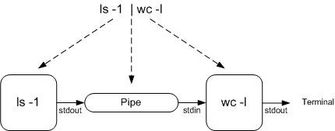
Command Pipeline
Shell set things up
create a pipe, “start” two programs simultaneously, with the first program’s output redirected to writing end of pipe, second program’s input redirected to reading end of pipe
individual program/command knows nothing about redirection and pipe

Slide 27
Rule of composition
Design programs to be connected with other programs
Read/write simple, textual, stream-oriented formats
Read from standard input and write to standard output
Filter: program that takes a simple text stream on input and process it into another simple text stream on output

Slide 28
The Power of Pipe
Find out how many subdirectories are there ?
Display the content of last edited file (under current directory)…
cat `ls –t | head -1`

Slide 29
Shell command line
A command ends with a newline, or a semicolon (;), or an ampersand (&)
date;
sleep 4; who
sleep 20&who
What’s the output ?
date; who | wc
| has higher precedence over ;
ls –l | grep ^d &
| has higher precedence over &
Use parenthesis to group commands
(date;who) | wc

Slide 30
Outline
Shell command line syntax
Shell builtin commands
Shell variables, arguments
I/O redirection
Shell tracing
Shell initialization

Slide 31
C/C++ topics: command line arguments
We learnt how to access command line arguments from shell, how about in C/C++ Program?
Example: write your own echo program
echo: display a line of text
$echo Good morning, everyone !
Good morning, everyone!
In C/C++, command line arguments are passed as parameters to main function
main(int argc, char * argv[])
argc: number of command line arguments, including command itself
argv: the arguments
argv[0]: the first word in the command line (the command name)
argv[1]: the second word in the command line

Slide 32
Simplified Echo program
Does not take options yet
#include <iostream>
using namespace std;
int main(int argc, char *argv[])
{
for (int i=1; i<argc; i++)
{
cout << argv[i] <<" ";
}
cout << endl;
}
char * argv[ ];
char argv[][[];
--- argv is an array of “char *”.
In C, there is no string class, and
string is represented as an array
of char.
char myName[256];
char * name;
name = myName;
A array variable actually stores the
address of the first element.

Slide 33
Outline
Shell command line syntax
Shell builtin commands
Shell variables, arguments
I/O redirection
Shell tracing
Shell Initialization and Termination

Slide 34
User Customization
shells read certain specified files on startup, and for some shells,also on termination.
We focus on bash here (different shell behaves differently)
If you write shell scripts that are intended to be used by others, you cannot rely on startup customizations. All of the shell scripts that we develop in this book set up their own environment (e.g., the value of $PATH) so that anyone can run them.

Slide 35
Login Shell versus Non-login Shell
Login shell: the shell that you talks to right after log in (from terminal, or remote log in using ssh command)
Nonlogin shell: the shell that you runs by typing “shell” command, or by running a shell script
Variable $0: indicates what shell you are in right now. Why?
[zhang@storm Codes]$ echo $0
-bash the “-” indicates it’s a login shell
[zhang@storm Codes]$ bash ## run a bash program,
[zhang@storm Codes]$ echo $0
bash this is non-login shell
[zhang@storm Codes]$ exit
exit exit the bash program
[zhang@storm Codes]$ echo $0
-bash back to login shell

Slide 36
Source command
A shell built-in command
Usage:
. filename [arguments]
source filename [arguments]
Read and execute commands from filename in current shell environment, and return exit status of last command executed from filename.
Demo: difference of running a script directly and source it
$ ./CountFiles
$ source CountFiles
Why?
When running a script directly, a new shell (non-login, non-interactive shell) is started to batch processing script …

Slide 37
Bash: startup initialization
For login shell:
test -r /etc/profile && . /etc/profile Try to read /etc/profile
if test -r $HOME/.bash_profile ; then Try three more possibilities
. $HOME/.bash_profile
elif test -r $HOME/.bash_login ; then
. $HOME/.bash_login
elif test -r $HOME/.profile ; then
. $HOME/.profile
fi
/etc/profile: System wide default, setting environment for all shell.
/etc/bashrc: System wide function and aliases for bash

Slide 38
Shell: startup initialization
Non-login interactive shell:
test -r $HOME/.bashrc && . $HOME/.bashrc Try to read $HOME/.bashrc
Non-login non-interactive shell:
test -r ″$BASH_ENV″ && eval . ″$BASH_ENV″
One can set BASH_ENV to point to an initialization file.

Slide 39
Export command
Take a look at typical settings
export command: a bulit-in command
Puts given variable into environment, a list of name-value pairs available to all programs
Will learn how to access environment from C/C++ program
A child process inherits environment from parent process
Variables not in environment not inherited
When setting PATH, needs to put it into environment, unless only for current script
examples

Slide 40
To test your settings
To test your changes to login shell initialization setting:
Reloggin
Run a script from current shell
source .bashrc , or . .bashrc
Change current shell’s settings

Slide 41
Summary
Shell command line syntax
Shell builtin commands
Shell variables, arguments
Argument variables
Command substitution
I/O redirection, pipe
Shell initialization

